Slide 1
Chapter 2 Intelligent Agents

Slide 2
Agents
An agent is anything that can be viewed as perceiving its environment through sensors and acting upon that environment through actuators
Human agent:
eyes, ears, and other organs for sensors;
hands, legs, mouth, and other body parts for
actuators
Robotic agent:
cameras and infrared range finders for sensors; various motors for actuators

Slide 3
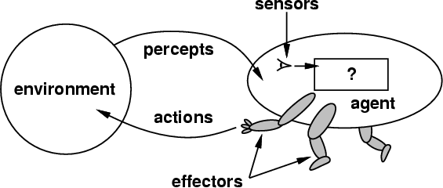
How to design an intelligent agent?
An intelligent agent perceives its environment via sensors and acts rationally upon that environment with its effectors.
A discrete agent receives percepts one at a time, and maps this percept sequence to a sequence of discrete actions.
Properties
Autonomous
Reactive to the environment
Pro-active (goal-directed)
Interacts with other agents
via the environment

Slide 4
Sensors/percepts and effectors/actions?
Humans
Sensors: Eyes (vision), ears (hearing), skin (touch), tongue (gustation), nose (olfaction), neuromuscular system (proprioception)
Percepts:
At the lowest level – electrical signals from these sensors
After preprocessing – objects in the visual field (location, textures, colors, …), auditory streams (pitch, loudness, direction), …
Effectors: limbs, digits, eyes, tongue, …
Actions: lift a finger, turn left, walk, run, carry an object, …

Slide 5
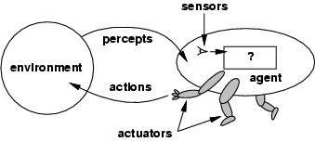
Agents and environments
The agent function maps from percept histories to actions:
[f: P* → A]
The agent program runs on the physical architecture to produce f
agent = architecture + program

Slide 6
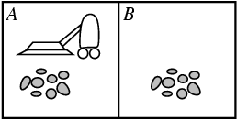
Vacuum-cleaner world
Percepts: location and state of the environment, e.g., [A,Dirty], [A,Clean], [B,Dirty]
Actions: Left, Right, Suck, NoOp

Slide 7
Rational agents
Performance measure: An objective criterion for success of an agent's behavior, e.g.,
Robot driver?
Chess-playing program?
Spam email classifier?
Rational Agent: selects actions that is expected to maximize its performance measure,
given percept sequence
given agent’s built-in knowledge
sidepoint: how to maximize expected future performance, given only historical data

Slide 8
Rational agents
Rational Agent → Always try to maximize performance.
No Agent is Omniscience. Rationality is distinct from omniscience (all-knowing with infinite knowledge)
Agents can perform actions in order to modify future percepts so as to obtain useful information (information gathering, exploration)
An agent is autonomous if its behavior is determined by its own percepts & experience (with ability to learn and adapt) without depending solely on built-in knowledge
To survive, agents must have:
Enough built-in knowledge to survive.
The ability to learn

Slide 9
Task Environment
Before we design an intelligent agent, we must specify its “task environment”:
PEAS:
Performance measure
Environment
Actuators
Sensors

Slide 10
DARPA Robotics Challenge
A prize competition funded by the US Defense Advanced Research Projects Agency, held from 2012 to 2015
Aimed to develop semi-autonomous ground robots that could do complex tasks in dangerous, degraded, human-engineered environments

Slide 11
DARPA Robotics Challenge
The initial task requirements for robot entries are
Drive a utility vehicle at the site
Travel dismounted across rubble
Remove debris blocking an entryway
Open a door and enter a building
Climb an industrial ladder and traverse an industrial walkway
Use a tool to break through a concrete panel
Locate and close a valve near a leaking pipe
Connect a fire hose to a standpipe and turn on a valve

Slide 12
PEAS
Example: Agent = robot driver in DARPA Challenge
Performance measure:
Time to complete course
Environment:
Roads, other traffic, obstacles
Actuators:
Steering wheel, accelerator, brake, signal, horn
Sensors:
Optical cameras, lasers, sonar, accelerometer, speedometer, GPS, odometer, engine sensors,

Slide 13
PEAS
Example: Agent = Medical diagnosis system
Performance measure:
Healthy patient, minimize costs, lawsuits
Environment:
Patient, hospital, staff
Actuators:
Screen display (questions, tests, diagnoses, treatments, referrals)
Sensors:
Keyboard (entry of symptoms, findings, patient's answers)

Slide 14
Environment types
Fully observable (vs. partially observable):
An agent's sensors give it access to the complete state of the environment at each point in time.
Deterministic (vs. stochastic):
The next state of the environment is completely determined by the current state and the action executed by the agent.
If the environment is deterministic except for the actions of other agents, then the environment is strategic
Deterministic environments can appear stochastic to an agent (e.g., when only partially observable)
Episodic (vs. sequential):
An agent’s action is divided into atomic episodes. Decisions do not depend on previous decisions/actions.

Slide 15
Environment types
Static (vs. dynamic):
The environment is unchanged while an agent is deliberating.
The environment is semidynamic if the environment itself does not change with the passage of time but the agent's performance score does
Discrete (vs. continuous):
A discrete set of distinct, clearly defined percepts and actions.
How we represent or abstract or model the world
Single agent (vs. multi-agent):
An agent operating by itself in an environment. Does the other agent interfere with my performance measure?

Slide 16
Characteristics of environments
 | Fully observable? | Deterministic | Episodic | Static | Discrete? | Single agent?
Solitaire
Driving
Internet shopping
Medical diagnosis

Slide 17
Characteristics of environments
 | Fully observable? | Deterministic? | Episodic? | Static? | Discrete? | Single agent?
Solitaire | No | Yes | Yes | Yes | Yes | Yes
Driving | No | No | No | No | No | No
Internet shopping
Medical diagnosis

Slide 18
Characteristics of environments
 | Fully observable? | Deterministic? | Episodic? | Static? | Discrete? | Single agent?
Solitaire | No | Yes | Yes | Yes | Yes | Yes
Driving | No | No | No | No | No | No
Internet shopping | No | No | No | No | Yes | No
Medical diagnosis

Slide 19
Characteristics of environments
 | Fully observable? | Deterministic? | Episodic? | Static? | Discrete? | Single agent?
Solitaire | No | Yes | Yes | Yes | Yes | Yes
Driving | No | No | No | No | No | No
Internet shopping | No | No | No | No | Yes | No
Medical diagnosis | No | No | No | No | No | Yes
→ Lots of real-world domains fall into the hardest case!

Slide 20
task environm. | observable | deterministic/ stochastic | episodic/ sequential | static/ dynamic | discrete/ continuous | agents
crossword puzzle | fully | determ. | sequential | static | discrete | single
chess with clock | fully | strategic | sequential | semi | discrete | multi
poker
taxi driving | partial | stochastic | sequential | dynamic | continuous | multi
medical diagnosis
image analysis | fully | determ. | episodic | semi | continuous | single
partpicking robot | partial | stochastic | episodic | dynamic | continuous | single
refinery controller | partial | stochastic | sequential | dynamic | continuous | single
interact. tutor | partial | stochastic | sequential | dynamic | discrete | multi

Slide 21
What is the environment for the DARPA Challenge?
Agent = robotic vehicle
Environment = 130-mile route through desert
Observable?
Deterministic?
Episodic?
Static?
Discrete?
Agents?

Slide 22
Agent types
Five basic types in order of increasing generality:
Table Driven agent
Simple reflex agents
Model-based reflex agents
Goal-based agents
Problem-solving agents
Utility-based agents
Can distinguish between different goals
Learning agents

Slide 23
Some agent types
Table-driven agents
use a percept sequence/action table in memory to find the next action. They are implemented by a (large) lookup table. It is not autonomous.
Simple reflex agents
are based on condition-action rules, implemented with an appropriate production system. They are stateless devices which do not have memory of past world states. It can not save history.
Agents with memory
have internal state, which is used to keep track of past states of the world.
Agents with goals
are agents that, in addition to state information, have goal information that describes desirable situations. Agents of this kind take future events into consideration. Never thinks about cost.
Utility-based agents
base their decisions on classic axiomatic utility theory in order to act rationally. Always thinks about cost.

Slide 24
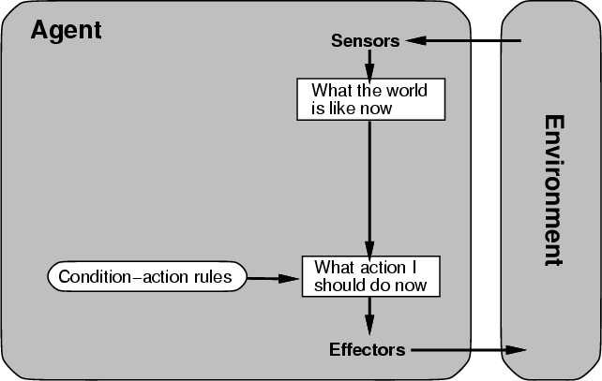
Table-driven/reflex agent Architecture

Slide 25
Table-driven agents
Table lookup of percept-action pairs mapping from every possible perceived state to the optimal action for that state
Problems
Too big to generate and to store (Chess has about 10¹²⁰ states, for example)
No knowledge of non-perceptual parts of the current state
Not adaptive to changes in the environment; requires entire table to be updated if changes occur
Looping: Can’t make actions conditional on previous actions/states

Slide 26
Simple reflex agents
Rule-based reasoning to map from percepts to optimal action; each rule handles a collection of perceived states
Problems
Still usually too big to generate and to store
Still not adaptive to changes in the environment; requires collection of rules to be updated if changes occur
Still can’t make actions conditional on previous state

Slide 27
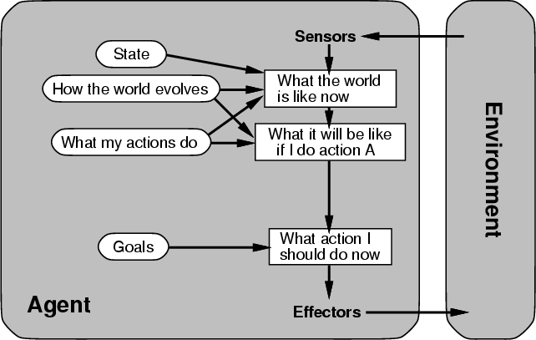
Goal-based agent: Architecture

Slide 28
Goal-based agents
Choose actions so as to achieve a (given or computed) goal.
A goal is a description of a desirable situation.
Keeping track of the current state is often not enough − need to add goals to decide which situations are good
Deliberative instead of reactive.
May have to consider long sequences of possible actions before deciding if goal is achieved – involves consideration of the future, “what will happen if I do...?”

Slide 29
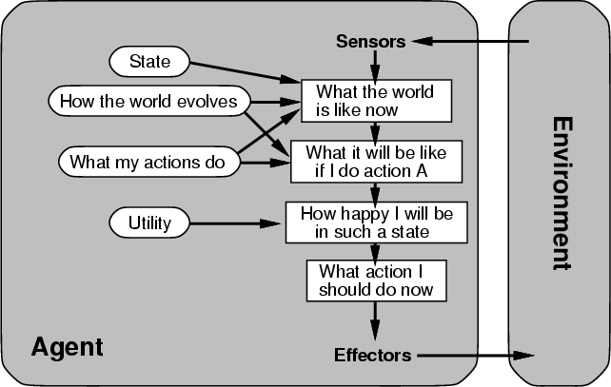
Complete utility-based agent

Slide 30
Utility-based agents
When there are multiple possible alternatives, how to decide which one is best?
A goal specifies a crude distinction between a happy and unhappy state, but often need a more general performance measure that describes “degree of happiness.”
Utility function U: State → Reals indicating a measure of success or happiness when at a given state.

Slide 31
Summary
An agent perceives and acts in an environment, has an architecture, and is implemented by an agent program.
An ideal agent always chooses the action which maximizes its expected performance, given its percept sequence so far.
An autonomous agent uses its own experience rather than built-in knowledge of the environment by the designer.

Slide 32
Summary (Contd.)
An agent program maps from percept to action and updates its internal state.
Reflex agents respond immediately to percepts.
Goal-based agents act in order to achieve their goal(s).
Utility-based agents maximize their own utility function.
Representing knowledge is important for successful agent design.
The most challenging environments are
partially observable
stochastic
sequential
Dynamic
continuous
contain multiple intelligent agents

